Slide 1
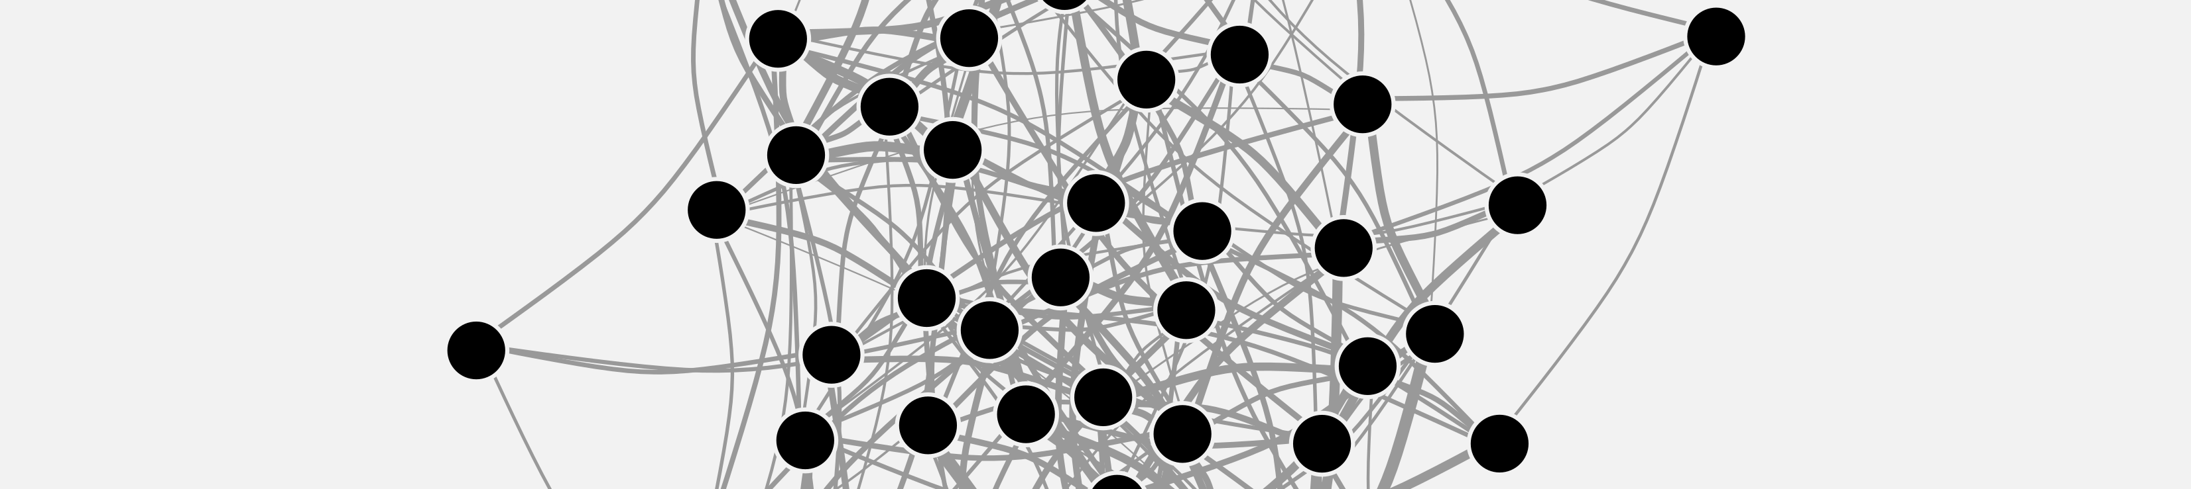


CEFE SOCIAL NETWORKS COURSE
Matthew Silk
matthewsilk@outlook.com

Slide 2
CEFE SOCIAL NETWORKS COURSE
Plan for the next two weeks:
TODAY – What is a network?
07/04/2023 - How do we describe network structures?
13/04/2023 - How do we test hypotheses in networks?
14/04/2023 - Extend our network skillset
Course materials: https://github.com/NETDEM-project/CEFE_Networks_Course

Slide 3
CEFE SOCIAL NETWORKS COURSE
Plan for today:
What is a network?
What do network datasets look like?
Network basics in R
Simple theoretical models of networks
Generating networks in R
Different network representations

Slide 4

CEFE SOCIAL NETWORKS COURSE
What is a network?
Networks represent interactions and consist of:
Nodes/vertices/actors
connected by
Links/edges

Slide 5
CEFE SOCIAL NETWORKS COURSE
What is a network?
Networks represent interactions and consist of:
Nodes/vertices/actors
connected by
Links/edges

Slide 6



CEFE SOCIAL NETWORKS COURSE
What is a network?
Nodes
Networks represent interactions and consist of:
Nodes/vertices/actors
connected by
Links/edges

Slide 7

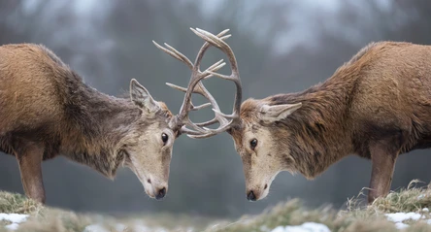
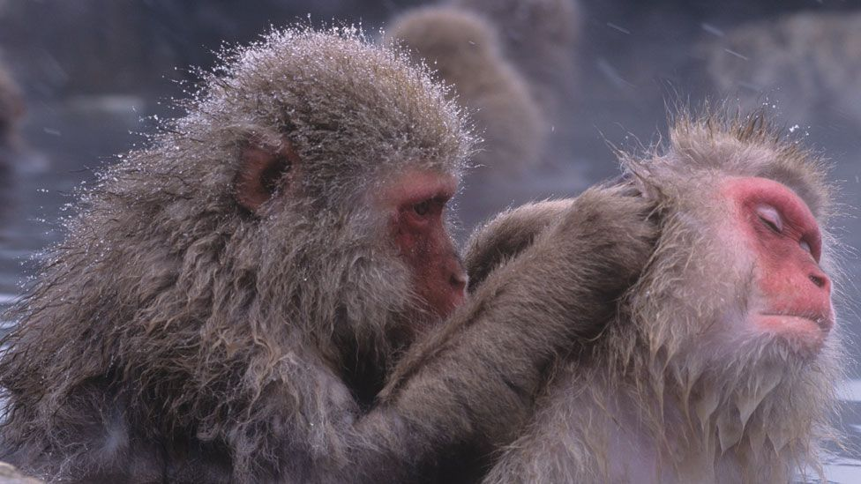


CEFE SOCIAL NETWORKS COURSE
What is a network?
Nodes
Networks represent interactions and consist of:
Nodes/vertices/actors
connected by
Links/edges
Edges

Slide 8
CEFE SOCIAL NETWORKS COURSE
What is a network?

Slide 9
CEFE SOCIAL NETWORKS COURSE
What is a network?
Networks help link individual behaviours to population patterns

Slide 10
CEFE SOCIAL NETWORKS COURSE
What do network datasets look like?
a) An ADJACENCY MATRIX
 | 1 | 2 | 3 | 4 | 5 | 6 | 7 | 8
1 | 0 | 1 | 1 | 0 | 0 | 1 | 0 | 0
2 | 1 | 0 | 0 | 1 | 0 | 0 | 0 | 0
3 | 1 | 0 | 0 | 1 | 1 | 0 | 0 | 0
4 | 0 | 1 | 1 | 0 | 0 | 0 | 0 | 0
5 | 0 | 0 | 1 | 0 | 0 | 1 | 1 | 0
6 | 1 | 0 | 0 | 0 | 1 | 0 | 1 | 0
7 | 0 | 0 | 0 | 0 | 1 | 1 | 0 | 1
8 | 0 | 0 | 0 | 0 | 0 | 0 | 1 | 0
1
2
3
4
5
6
7
8

Slide 11
CEFE SOCIAL NETWORKS COURSE
What do network datasets look like?
b) An EDGE LIST
ID 1 | ID 2
1 | 2
1 | 3
1 | 6
2 | 4
3 | 4
3 | 5
5 | 6
5 | 7
6 | 7
7 | 8
1
2
3
4
5
6
7
8

Slide 12
CEFE SOCIAL NETWORKS COURSE
What do network datasets look like?
b) An EDGE LIST
ID 1 | ID 2 | Attribute
1 | 2
1 | 3
1 | 6
2 | 4
3 | 4
3 | 5
5 | 6
5 | 7
6 | 7
7 | 8
1
2
3
4
5
6
7
8

Slide 13
CEFE SOCIAL NETWORKS COURSE
What do network datasets look like?
b) An INCIDENCE MATRIX or GROUP-BY-INDIVIDUAL MATRIX
Groups
1
2
3
4
5
6
7
8
9
10
Individuals | 2 | 3 | 4 | 5 | 6 | 7 | 8
1 | 2 | 3 | 4 | 5 | 6 | 7 | 8
1 | 1 | 0 | 0 | 0 | 0 | 0 | 0
1 | 0 | 1 | 0 | 0 | 0 | 0 | 0
1 | 0 | 0 | 0 | 0 | 1 | 0 | 0
0 | 1 | 0 | 1 | 0 | 0 | 0 | 0
0 | 0 | 1 | 1 | 0 | 0 | 0 | 0
0 | 0 | 1 | 0 | 1 | 0 | 0 | 0
0 | 0 | 0 | 0 | 1 | 1 | 0 | 0
0 | 0 | 0 | 0 | 1 | 0 | 1 | 0
0 | 0 | 0 | 0 | 0 | 1 | 1 | 0
0 | 0 | 0 | 0 | 0 | 0 | 1 | 1
1
2
3
4
5
6
7
8

Slide 14
CEFE SOCIAL NETWORKS COURSE
Network basics in R
Now head to the R Markdown for Session 1 and work through the section SESSION 1: PART 3

Slide 15
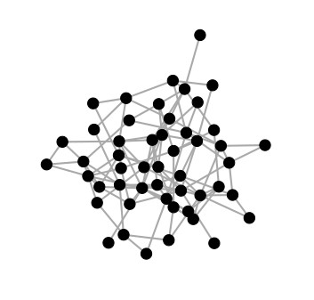
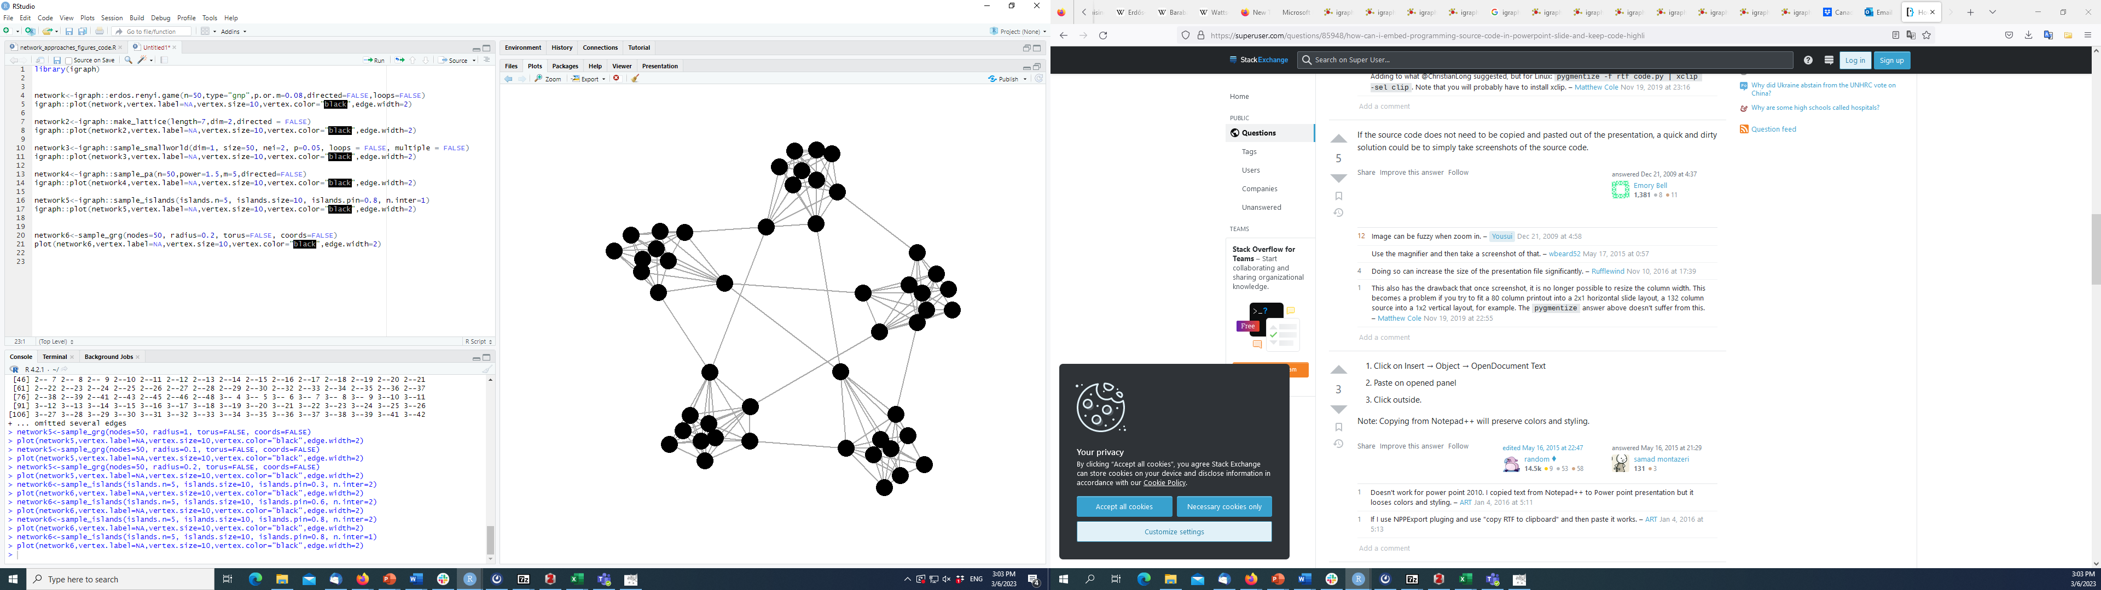
CEFE SOCIAL NETWORKS COURSE
Simple theoretical models of networks
Random networks
Erdos-renyi model
The most basic network model
Requires only a probability of edges or number of edges, and a number of nodes
Edges conditionally independent

Slide 16
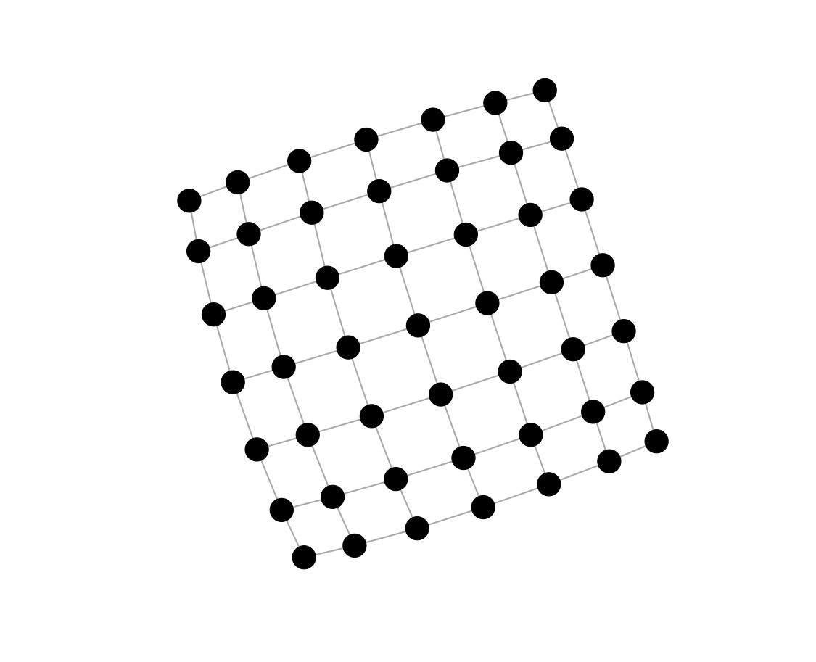
CEFE SOCIAL NETWORKS COURSE
Simple theoretical models of networks
Lattice network
A basic “geographic” model
Connections between neighbours in a lattice
Can specify the lattice to have any dimension you like

Slide 17
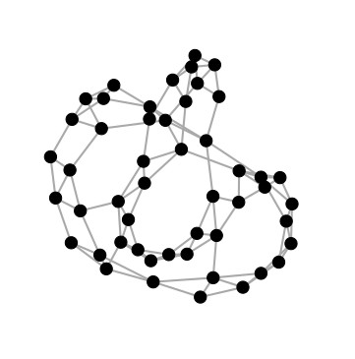
CEFE SOCIAL NETWORKS COURSE
Simple theoretical models of networks
Small-world networks
Watts-Strogatz model
Extends a lattice model to include occasional long-distance connections
Often a good approximation for many real-world social networks
Characterised by clustering of nodes but still with short routes across the network

Slide 18
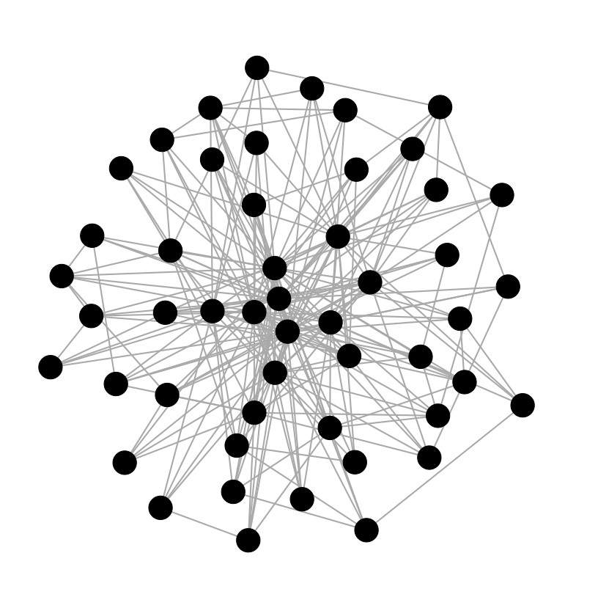
CEFE SOCIAL NETWORKS COURSE
Simple theoretical models of networks
Preferential attachment
Barabasi-Albert model
A model that allows individuals to vary in their “sociality” or “popularity”
Uses a mechanism called preferential attachment
Animal social networks often have these heterogeneous degree distributions
(but may not be scale free)

Slide 19
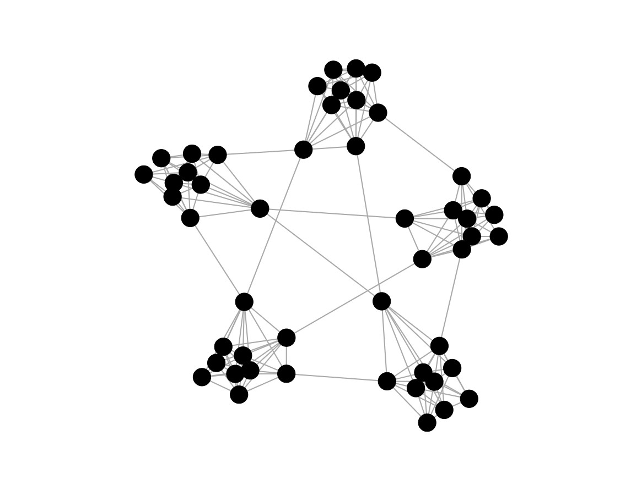
CEFE SOCIAL NETWORKS COURSE
Simple theoretical models of networks
Modular networks
An example of a model that can generate networks with group or (community/modular) structure
These types of modular network are common in some animal societies

Slide 20
CEFE SOCIAL NETWORKS COURSE
Generating networks in R
A full list of igraph functions is here: https://igraph.org/r/html/latest/
You can find a lot of functions to generate simple networks by searching “game” in this list

Slide 21
CEFE SOCIAL NETWORKS COURSE
Generating networks in R
A full list of igraph functions is here: https://igraph.org/r/html/latest/
You can find a lot of functions to generate simple networks by searching “game” in this list
1. Go to the R Markdown for Session 1 and work through the section SESSION 1: PART 4
2. In groups find models and simulate networks for:
A species with stable social groups that never mix
A territorial species with occasional long-distance dispersal
A species with fission-fusion social groups that separate and come back together
A species with social groups with some individuals much more connected than others

Slide 22
CEFE SOCIAL NETWORKS COURSE
Different network representations
We have started with the most simple way to think about animal social networks – recording simply whether two individuals share a social connection or not.
BUT
The social lives of animals are much more complex than this, so in the next section we are going to go through different ways to include extra information in our social network representations.

Slide 23
CEFE SOCIAL NETWORKS COURSE
Different network representations
We have started with the most simple way to think about animal social networks – recording simply whether two individuals share a social connection or not.
BUT
The social lives of animals are much more complex than this, so in the next section we are going to go through different ways to include extra information in our social network representations.
We will start with types of static representation that ignore how interactions might change over time to account for:
The frequency and duration of interactions (weighted networks and multigraphs)
Who interacted with whom (directed networks and ego networks)
Different types of behaviour (multilayer networks)
Indirect interactions (bipartite networks)
Group interactions (higher-order networks)

Slide 24
CEFE SOCIAL NETWORKS COURSE
Different network representations
We have started with the most simple way to think about animal social networks – recording simply whether two individuals share a social connection or not.
BUT
The social lives of animals are much more complex than this, so in the next section we are going to go through different ways to include extra information in our social network representations.
We will start with types of static representation that ignore how interactions might change over time to account for:
The frequency and duration of interactions (weighted networks and multigraphs)
Who interacted with whom (directed networks and ego networks)
Different types of behaviour (multilayer networks)
Indirect interactions (bipartite networks)
Group interactions (higher-order networks)
We will then finish by thinking about dynamic representations that include information about temporal changes to interaction patterns

Slide 25
CEFE SOCIAL NETWORKS COURSE
Static network representations
Weighted networks are commonly used to study animal social networks
Also provide information on the strength of social connections
ID 1 | ID 2 | Attribute
1 | 2 | 3
1 | 3 | 1
1 | 6 | 1
2 | 4 | 1
3 | 4 | 1
3 | 5 | 1
5 | 6 | 2
5 | 7 | 2
6 | 7 | 2
7 | 8 | 1
 | 1 | 2 | 3 | 4 | 5 | 6 | 7 | 8
1 | 0 | 3 | 1 | 0 | 0 | 1 | 0 | 0
2 | 3 | 0 | 0 | 1 | 0 | 0 | 0 | 0
3 | 1 | 0 | 0 | 1 | 1 | 0 | 0 | 0
4 | 0 | 1 | 1 | 0 | 0 | 0 | 0 | 0
5 | 0 | 0 | 1 | 0 | 0 | 2 | 2 | 0
6 | 1 | 0 | 0 | 0 | 2 | 0 | 2 | 0
7 | 0 | 0 | 0 | 0 | 2 | 2 | 0 | 1
8 | 0 | 0 | 0 | 0 | 0 | 0 | 1 | 0
1
2
3
4
5
6
7
8

Slide 26
CEFE SOCIAL NETWORKS COURSE
Static network representations
There are lots of different ways to weight social network edges
Counts of associations/interactions

Slide 27
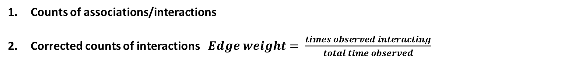
CEFE SOCIAL NETWORKS COURSE
Static network representations
There are lots of different ways to weight social network edges
Counts of associations/interactions
Corrected counts of interactions $Edge weight= \frac{times observed interacting}{total time observed}$

Slide 28
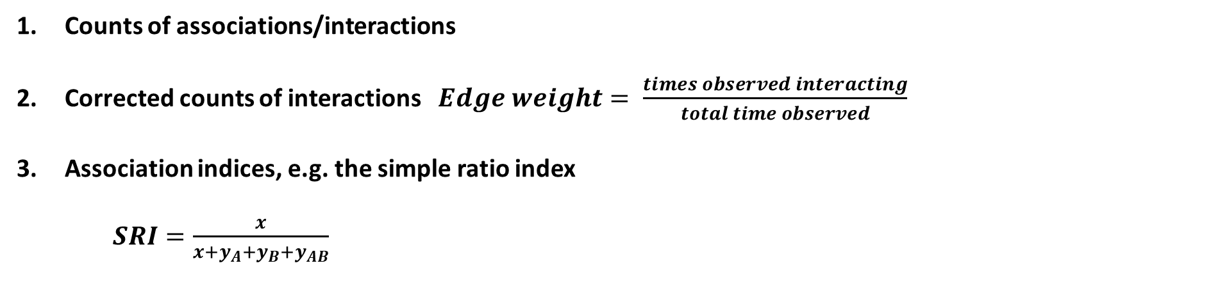
CEFE SOCIAL NETWORKS COURSE
Static network representations
There are lots of different ways to weight social network edges
Counts of associations/interactions
Corrected counts of interactions $Edge weight= \frac{times observed interacting}{total time observed}$
Association indices, e.g. the simple ratio index
$SRI=\frac{x}{x+y_{A}+y_{B}+y_{AB}}$
Lots of variations which are described here: https://doi.org/10.1016/j.anbehav.2017.08.029
Number of times A and B observed together
Number of times just A observed
Number of times just B observed
Number of times A and B observed separately

Slide 29
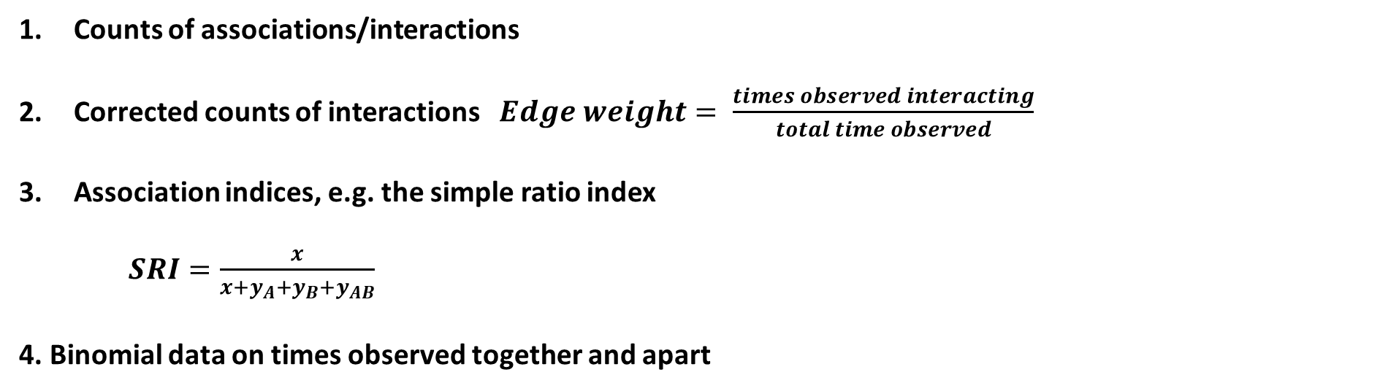
CEFE SOCIAL NETWORKS COURSE
Static network representations
There are lots of different ways to weight social network edges
Counts of associations/interactions
Corrected counts of interactions $Edge weight= \frac{times observed interacting}{total time observed}$
Association indices, e.g. the simple ratio index
$SRI=\frac{x}{x+y_{A}+y_{B}+y_{AB}}$
4. Binomial data on times observed together and apart
Lots of variations which are described here: https://doi.org/10.1016/j.anbehav.2017.08.029
Good description of why this is a good method: https://doi.org/10.1101/2021.12.20.473541

Slide 30
CEFE SOCIAL NETWORKS COURSE
Static network representations
An alternative to using weighted networks is to use multigraphs
Sometimes the number of strength of interactions/associations provide different information
ID 1 | ID 2 | Attribute
1 | 2 | 3
1 | 3 | 1
1 | 6 | 1
2 | 4 | 1
3 | 4 | 1
3 | 5 | 1
5 | 6 | 2
5 | 7 | 2
6 | 7 | 2
7 | 8 | 1
 | 1 | 2 | 3 | 4 | 5 | 6 | 7 | 8
1 | 0 | 3 | 1 | 0 | 0 | 1 | 0 | 0
2 | 3 | 0 | 0 | 1 | 0 | 0 | 0 | 0
3 | 1 | 0 | 0 | 1 | 1 | 0 | 0 | 0
4 | 0 | 1 | 1 | 0 | 0 | 0 | 0 | 0
5 | 0 | 0 | 1 | 0 | 0 | 2 | 2 | 0
6 | 1 | 0 | 0 | 0 | 2 | 0 | 2 | 0
7 | 0 | 0 | 0 | 0 | 2 | 2 | 0 | 1
8 | 0 | 0 | 0 | 0 | 0 | 0 | 1 | 0
1
2
3
4
5
6
7
8

Slide 31
CEFE SOCIAL NETWORKS COURSE
Static network representations
So when might you want to use weighted networks versus multigraphs?
The distinction between weighted networks and multigraphs is most useful when both their number/frequency and duration are important.
Considering multigraphs can also be helpful when designing permutation procedures for analysing the networks.

Slide 32
CEFE SOCIAL NETWORKS COURSE
Static network representations
You can also create directed networks
ID 1 | ID 2 | Attribute
1 | 2 | 3
1 | 3 | 1
2 | 4 | 1
3 | 5 | 1
4 | 3 | 1
5 | 7 | 2
6 | 1 | 1
6 | 5 | 2
6 | 7 | 2
7 | 8 | 1
 | 1 | 2 | 3 | 4 | 5 | 6 | 7 | 8
1 | 0 | 3 | 0 | 0 | 0 | 0 | 0 | 0
2 | 0 | 0 | 0 | 1 | 0 | 0 | 0 | 0
3 | 1 | 0 | 0 | 0 | 1 | 0 | 0 | 0
4 | 0 | 0 | 1 | 0 | 0 | 0 | 0 | 0
5 | 0 | 0 | 0 | 0 | 0 | 0 | 2 | 0
6 | 1 | 0 | 0 | 0 | 2 | 0 | 2 | 0
7 | 0 | 0 | 0 | 0 | 0 | 0 | 0 | 1
8 | 0 | 0 | 0 | 0 | 0 | 0 | 0 | 0
1
2
3
4
5
6
7
8

Slide 33
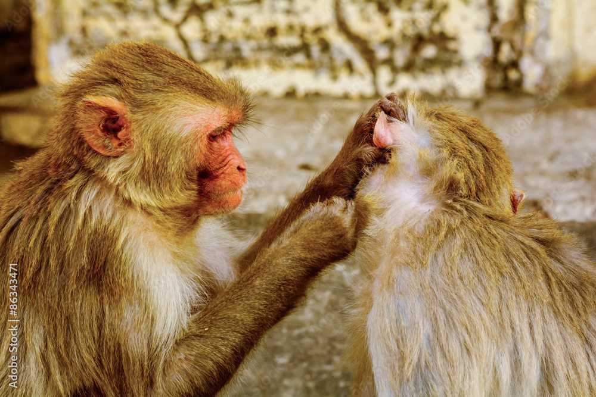
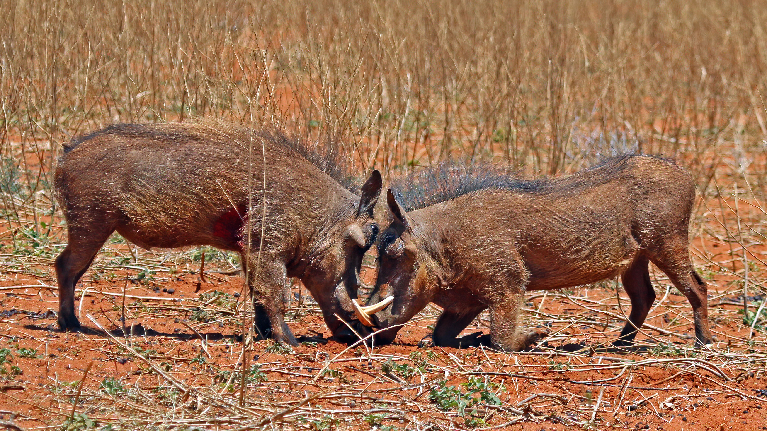
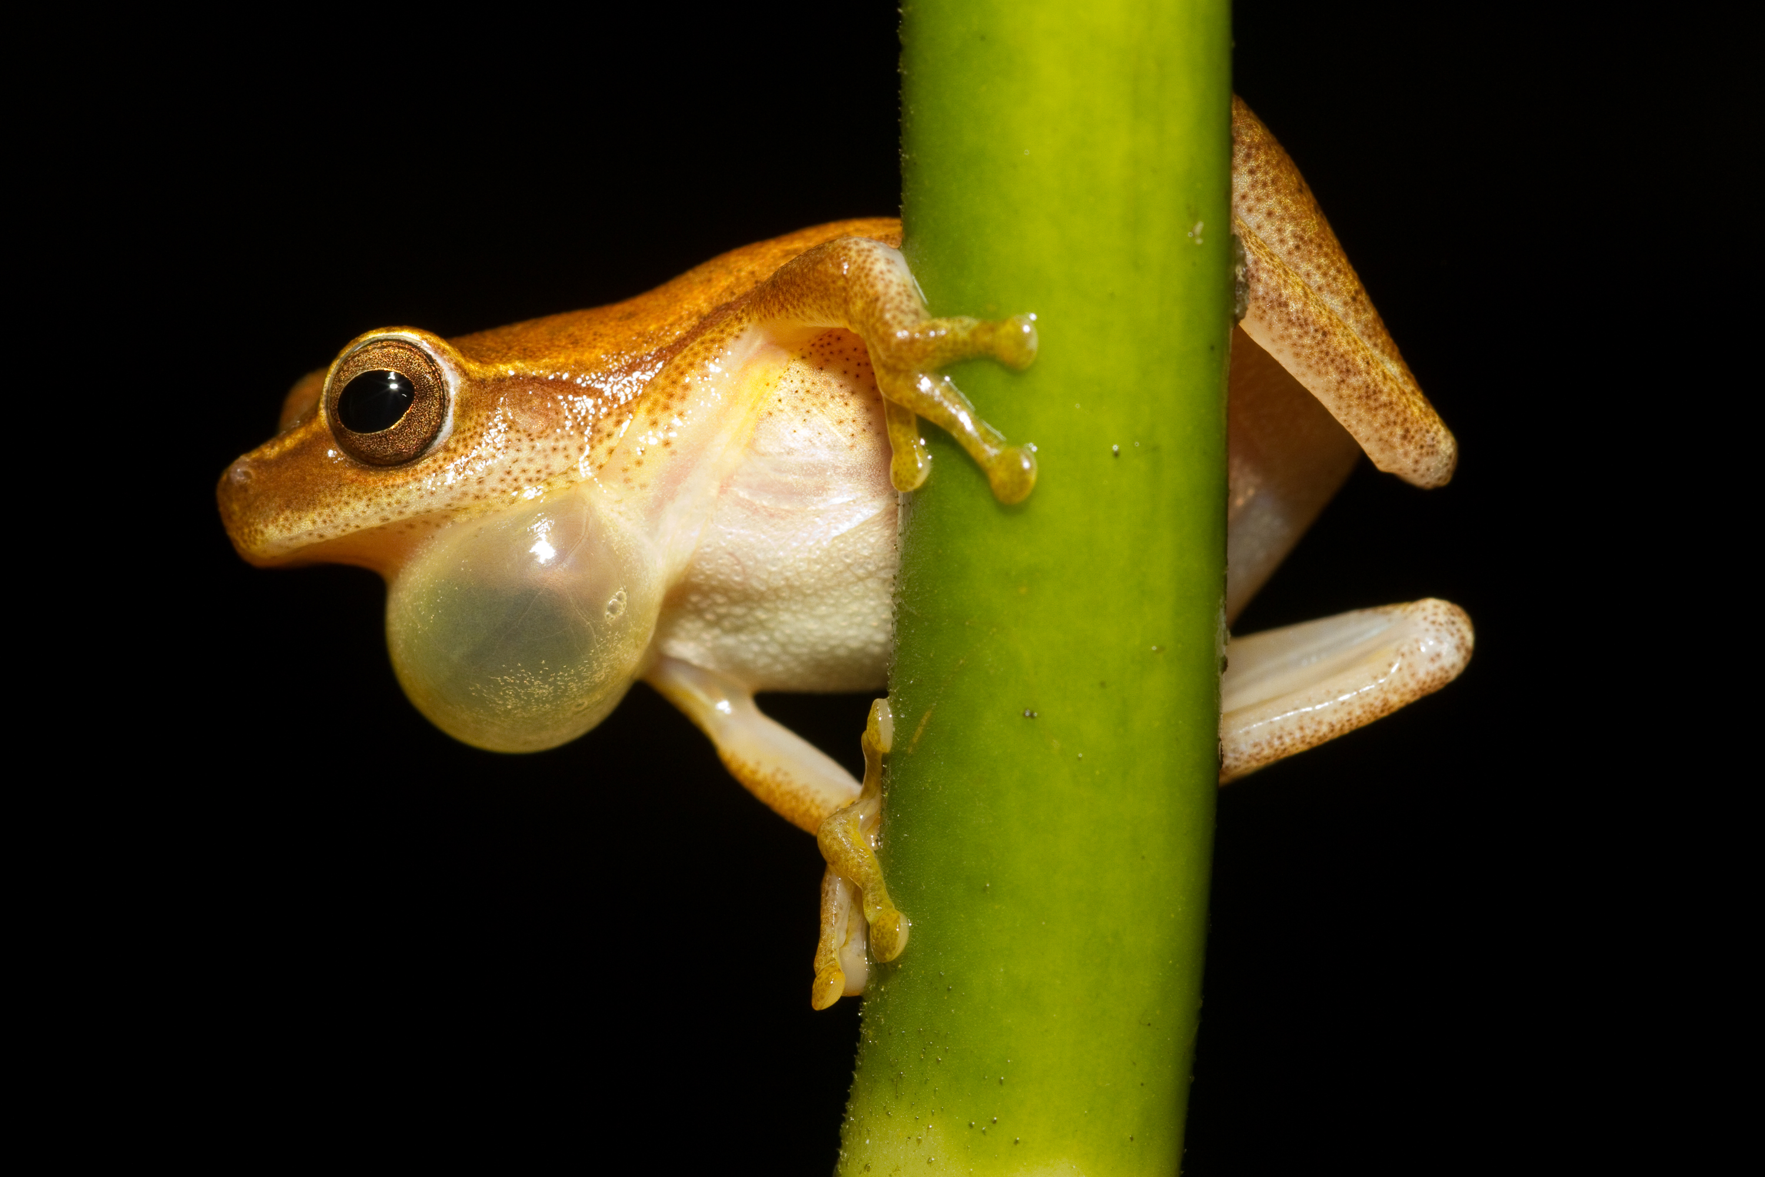
CEFE SOCIAL NETWORKS COURSE
Static network representations
You can also create directed networks
1
2
3
4
5
6
7
8

Slide 34
CEFE SOCIAL NETWORKS COURSE
Static network representations
You can also create directed networks
1
2
3
4
5
6
7
Some network motifs like TRANSITIVE triads are a feature of animal dominance hierarchies
8

Slide 35
CEFE SOCIAL NETWORKS COURSE
Static network representations
With limited data or sampling power it can be helpful to think about ego networks

Slide 36
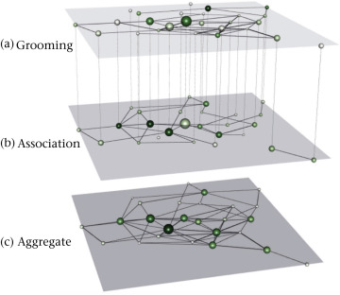
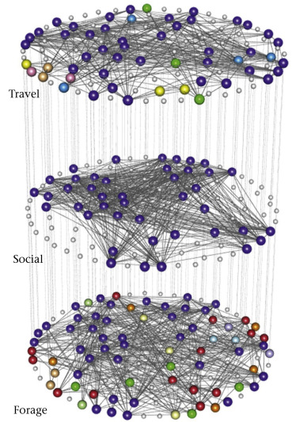
CEFE SOCIAL NETWORKS COURSE
Static network representations
Multilayer networks are a tool to represent multiple sets of interactions that depend on each other
Multiplex networks

Slide 37
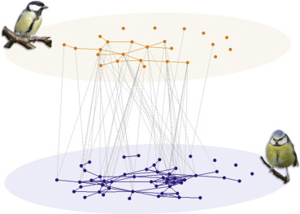
CEFE SOCIAL NETWORKS COURSE
Static network representations
Multilayer networks are a tool to represent multiple sets of interactions that depend on each other
Multiplex networks
Interconnected networks

Slide 38
CEFE SOCIAL NETWORKS COURSE
Static network representations
Multilayer networks are a tool to represent multiple sets of interactions that depend on each other
Important things to think about before using this representation:
Are my behaviours sufficiently different to represent as different layers?
Does one behaviour depend on another? (e.g. grooming requires proximity)
Can I scale edge weights and directions to make sense?
Multiplex networks

Slide 39
CEFE SOCIAL NETWORKS COURSE
Static network representations
Multilayer networks are a tool to represent multiple sets of interactions that depend on each other
 | 1 | 2 | 3 | 4 | 5 | 6 | 7 | 8
1 | 0 | 3 | 1 | 0 | 0 | 1 | 0 | 0
2 | 3 | 0 | 0 | 1 | 0 | 0 | 0 | 0
3 | 1 | 0 | 0 | 1 | 1 | 0 | 0 | 0
4 | 0 | 1 | 1 | 0 | 0 | 0 | 0 | 0
5 | 0 | 0 | 1 | 0 | 0 | 2 | 2 | 0
6 | 1 | 0 | 0 | 0 | 2 | 0 | 2 | 0
7 | 0 | 0 | 0 | 0 | 2 | 2 | 0 | 1
8 | 0 | 0 | 0 | 0 | 0 | 0 | 1 | 0
 | 1 | 2 | 3 | 4 | 5 | 6 | 7 | 8
1 | 0 | 2 | 0 | 1 | 0 | 2 | 0 | 0
2 | 2 | 0 | 0 | 1 | 0 | 0 | 0 | 0
3 | 0 | 0 | 0 | 0 | 3 | 1 | 0 | 0
4 | 1 | 3 | 1 | 0 | 1 | 0 | 0 | 0
5 | 0 | 1 | 3 | 1 | 0 | 4 | 1 | 0
6 | 2 | 0 | 1 | 0 | 4 | 0 | 3 | 2
7 | 0 | 0 | 0 | 0 | 1 | 3 | 0 | 1
8 | 0 | 0 | 0 | 0 | 0 | 2 | 1 | 0
ID 1 | ID 2 | Weight | Layer
1 | 2 | 3 | 1
1 | 3 | 1 | 1
1 | 6 | 1 | 1
2 | 4 | 1 | 1
3 | 4 | 1 | 1
3 | 5 | 1 | 1
5 | 6 | 2 | 1
5 | 7 | 2 | 1
6 | 7 | 2 | 1
7 | 8 | 1 | 1
Multiplex networks

Slide 40
CEFE SOCIAL NETWORKS COURSE
Static network representations
Multilayer networks are a tool to represent multiple sets of interactions that depend on each other
 | A1 | A2 | A3 | A4 | B1 | B2 | B3 | B4
A1 | 0 | 3 | 1 | 0 | 0 | 1 | 0 | 0
A2 | 3 | 0 | 0 | 1 | 0 | 0 | 0 | 0
A3 | 1 | 0 | 0 | 1 | 1 | 0 | 0 | 0
A4 | 0 | 1 | 1 | 0 | 0 | 0 | 0 | 0
B1 | 0 | 0 | 1 | 0 | 0 | 2 | 2 | 0
B2 | 1 | 0 | 0 | 0 | 2 | 0 | 2 | 0
B3 | 0 | 0 | 0 | 0 | 2 | 2 | 0 | 1
B4 | 0 | 0 | 0 | 0 | 0 | 0 | 1 | 0
Interlayer edges
Intralayer edges
Supra-adjacency matrix
Interconnected networks

Slide 41
CEFE SOCIAL NETWORKS COURSE
Static network representations
Multilayer networks are a tool to represent multiple sets of interactions that depend on each other
 | 1A | 2A | 3A | 4A | 1B | 2B | 3B | 4B
1A | 0 | 3 | 1 | 0 | 1 | 0 | 0 | 0
2A | 3 | 0 | 0 | 1 | 0 | 1 | 0 | 0
3A | 1 | 0 | 0 | 1 | 0 | 0 | 1 | 0
4A | 0 | 1 | 1 | 0 | 0 | 0 | 0 | 1
1B | 1 | 0 | 0 | 0 | 0 | 2 | 2 | 0
2B | 0 | 1 | 0 | 0 | 2 | 0 | 2 | 0
3B | 0 | 0 | 1 | 0 | 2 | 2 | 0 | 1
4B | 0 | 0 | 0 | 1 | 0 | 0 | 1 | 0
Interlayer edges
Intralayer edges
Supra-adjacency matrix
Multiplex network

Slide 42
CEFE SOCIAL NETWORKS COURSE
Static network representations
Bipartite networks are a tool to represent interactions between different types of node
Resource use networks

Slide 43
CEFE SOCIAL NETWORKS COURSE
Static network representations
Bipartite networks are a tool to represent interactions between different types of node
Resource use networks
Mating networks

Slide 44
CEFE SOCIAL NETWORKS COURSE
Static network representations
Bipartite networks are a tool to represent interactions between different types of node
Places
1
2
3
4
5
6
7
8
9
10
Individuals | 2 | 3 | 4 | 5 | 6 | 7 | 8
1 | 2 | 3 | 4 | 5 | 6 | 7 | 8
1 | 1 | 0 | 0 | 1 | 0 | 0 | 0
1 | 0 | 1 | 0 | 0 | 0 | 0 | 0
1 | 0 | 0 | 0 | 0 | 0 | 0 | 0
0 | 1 | 0 | 1 | 1 | 1 | 1 | 0
0 | 0 | 1 | 1 | 0 | 0 | 0 | 1
0 | 0 | 1 | 0 | 0 | 0 | 0 | 0
0 | 0 | 0 | 0 | 1 | 1 | 0 | 0
0 | 0 | 0 | 0 | 1 | 0 | 0 | 0
0 | 0 | 0 | 0 | 0 | 1 | 1 | 0
0 | 0 | 0 | 0 | 0 | 0 | 1 | 1
Can be represented using an INCIDENCE MATRIX

Slide 45
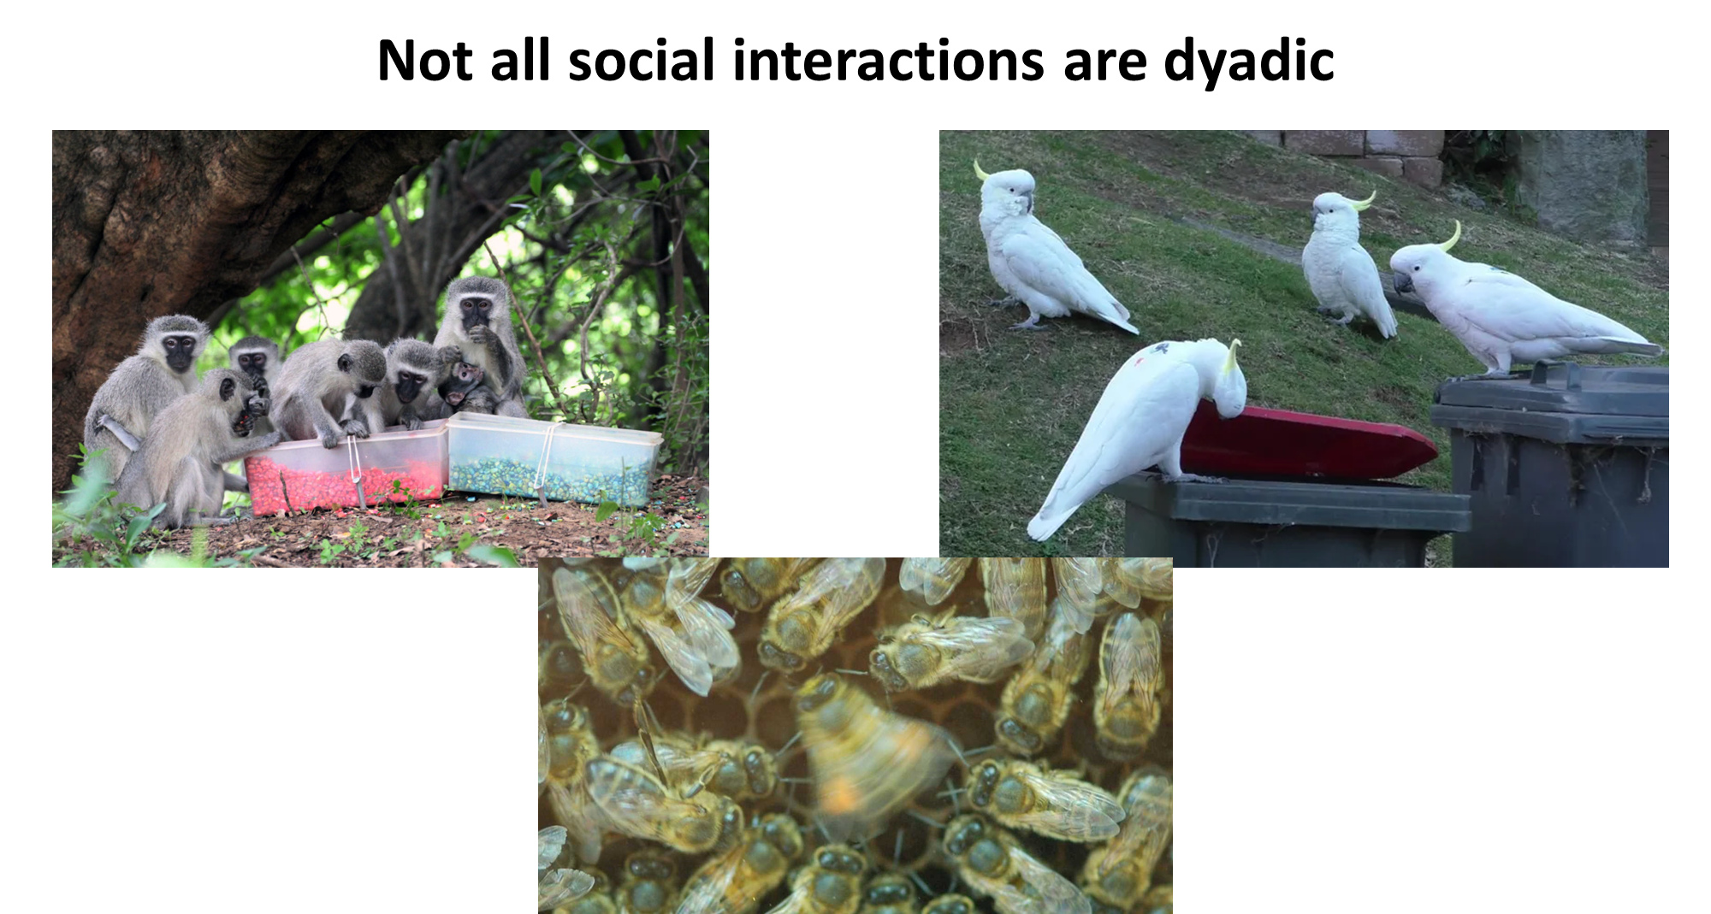
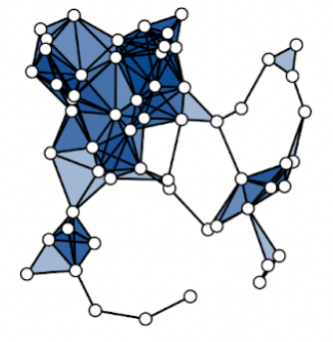
CEFE SOCIAL NETWORKS COURSE
Static network representations
Higher-order networks are a tool to represent interactions that can be between more than two individuals

Slide 46
CEFE SOCIAL NETWORKS COURSE
Static network representations
Higher-order networks are a tool to represent interactions that can be between more than two individuals

Slide 47
CEFE SOCIAL NETWORKS COURSE
Static network representations
Higher-order networks are a tool to represent interactions that can be between more than two individuals
Higher-order networks let us include information on the size of interactions.
An “edge” can now connect more than two individuals at a time.
Simplest type of higher-order is the HYPERGRAPH in which nodes are connected by hyperedges

Slide 48
CEFE SOCIAL NETWORKS COURSE
Static network representations
Higher-order networks are a tool to represent interactions that can be between more than two individuals
Hyperedges
1
2
3
4
5
6
7
8
Individuals | 2 | 3 | 4 | 5 | 6 | 7 | 8
1 | 2 | 3 | 4 | 5 | 6 | 7 | 8 | 9 | 10
1 | 1 | 0 | 0 | 0 | 0 | 0 | 0 | 0 | 0
1 | 1 | 1 | 1 | 1 | 0 | 0 | 0 | 0 | 0
0 | 0 | 1 | 1 | 0 | 0 | 0 | 0 | 0 | 0
0 | 0 | 0 | 0 | 1 | 1 | 0 | 0 | 0 | 0
0 | 0 | 0 | 0 | 0 | 1 | 1 | 1 | 0 | 0
0 | 0 | 0 | 0 | 0 | 0 | 1 | 0 | 1 | 0
0 | 0 | 0 | 0 | 0 | 0 | 0 | 1 | 0 | 1
0 | 0 | 0 | 0 | 0 | 0 | 0 | 0 | 1 | 1
9
7
10
8
6
2
5
1
4
3
Can be represented using an INCIDENCE MATRIX

Slide 49
CEFE SOCIAL NETWORKS COURSE
Dynamic network representations
We may also need to represent the temporal dynamics of networks
All network data starts with a temporal component
Most efficiently stored as edge lists
We have to decide:
If it is important to include?
How to include it?
ID 1 | ID 2 | Weight | Time
1 | 2 | 3 | 01/01/2023 07:45
1 | 3 | 1 | 01/01/2023 07:49
1 | 6 | 1 | 03/01/2023 10:18
2 | 4 | 1 | 01/01/2023 07:59
3 | 4 | 1 | 01/01/2023 11:47
3 | 5 | 1 | 02/01/2023 15:32
5 | 6 | 2 | 02/01/2023 09:46
5 | 7 | 2 | 02/01/2023 16:02
6 | 7 | 2 | 01/01/2023 08:30
7 | 8 | 1 | 04/01/2023 12:35

Slide 50
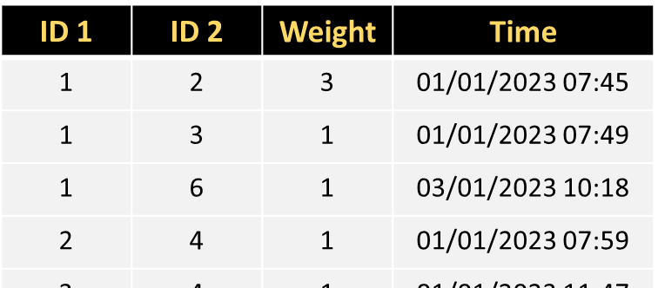
CEFE SOCIAL NETWORKS COURSE
Dynamic network representations
We may also need to represent the temporal dynamics of networks
We have to decide:
2) How to include it?
TIME-ORDERED NETWORKS
TIME-AGGREGATED NETWORKS
t=1
t=2
t=3

Slide 51
CEFE SOCIAL NETWORKS COURSE
Dynamic network representations
We may also need to represent the temporal dynamics of networks
TIME-ORDERED NETWORKS
Retain the most information about the system
Fewer subjective decisions required
Harder to work with – few descriptive measures and models are available

Slide 52
CEFE SOCIAL NETWORKS COURSE
Dynamic network representations
We may also need to represent the temporal dynamics of networks
Adopts same data structures and models as static networks
More statistical tools available
Need to decide how to aggregate the social data
Snapshots (single moment in time)
Aggregate over biologically justified timescales
Rolling windows (e.g. months 1-3, months 2-4 etc.)
TIME-AGGREGATED NETWORKS
t=1
t=2
t=3

Slide 53
CEFE SOCIAL NETWORKS COURSE
Different network representations
1. Go to the R Markdown for Session 1 and work through the section SESSION 1: PART 6

Slide 54
CEFE SOCIAL NETWORKS COURSE
Plan for the next two weeks:
03/04/2023 – What is a network?
TODAY - How do we describe network structures?
13/04/2023 - How do we test hypotheses in networks?
14/04/2023 - Extend our network skillset
Course materials: https://github.com/NETDEM-project/CEFE_Networks_Course

Slide 55
CEFE SOCIAL NETWORKS COURSE
Plan for today:
The basics of network structure
Describing node-level or microscale structure of networks
Describing mesoscale structure of networks
Describing macroscale structure of networks

Slide 56
CEFE SOCIAL NETWORKS COURSE

Slide 57
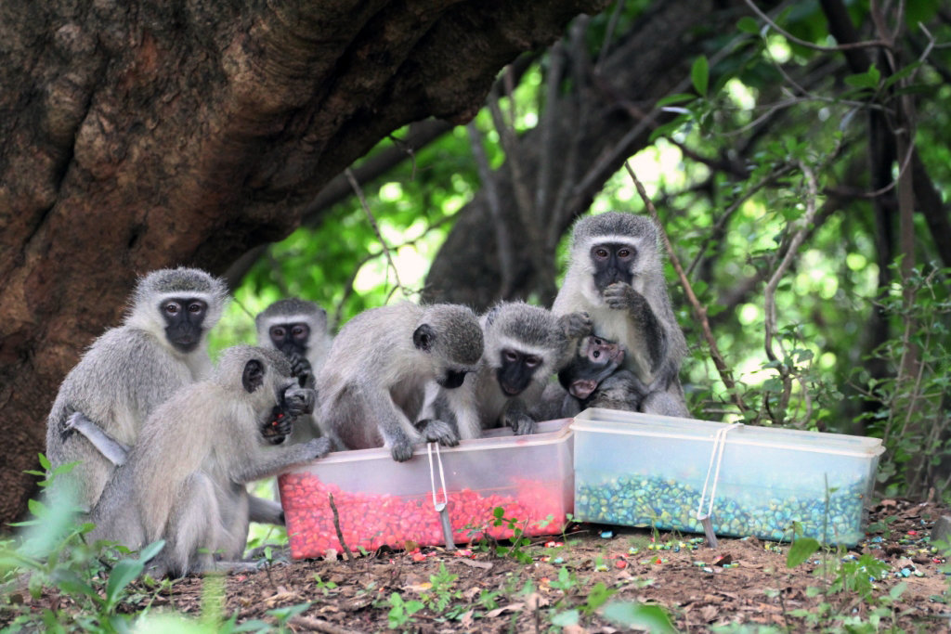

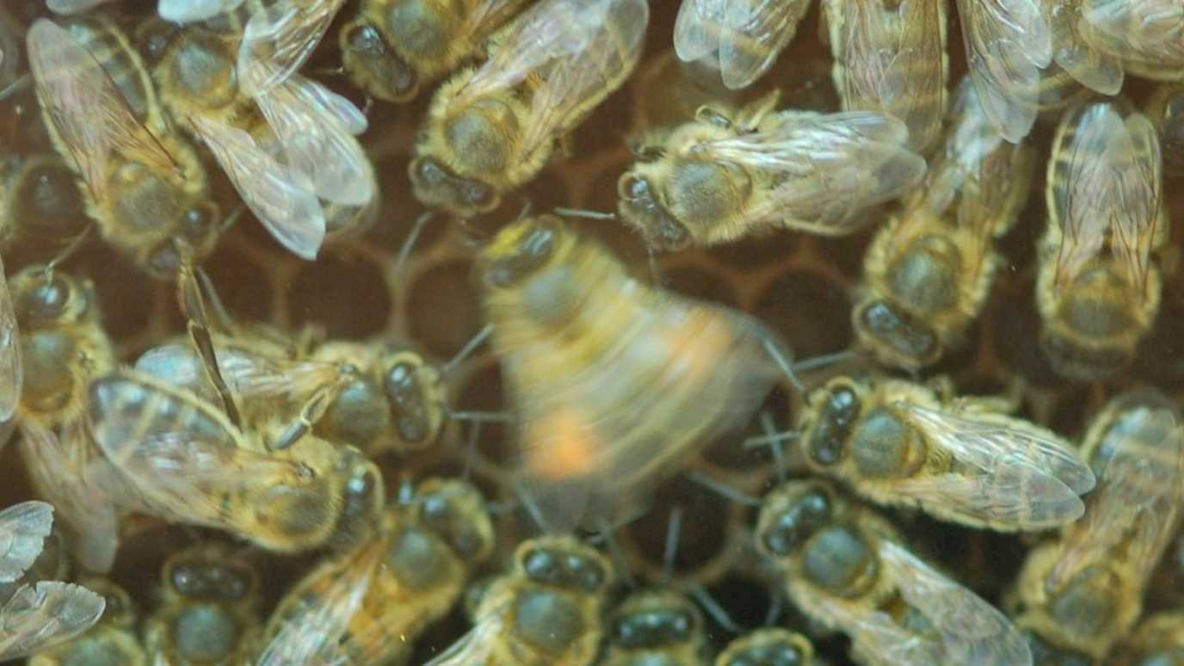
Not all social interactions are dyadic

